Slide 1

EDA Project on AMCAT

Slide 2
About me:-
I’m Prabhu Charan . I have completed my graduation in Btech
I’m a passionate individual with an insatiable curiosity for data science. My enthusiasm drives me to explore the intricacies of data analysis, machine learning, and predictive modeling. I thrive on uncovering meaningful insights from complex datasets, constantly seeking to expand my knowledge and skills in this dynamic field through data-driven decision-making.

Slide 3
ObjectiveS of the Project:
To analyze the given dataset.
The analysis aims to gain insights and understanding from the provided dataset.
Focusing on the relationship between various features and the target variable which is salary.
To come up with a conclusion and insight.

Slide 4
Summary of the data:
The Aspiring Mind Employment Outcome 2015(AMEO) dataset , released by Aspiring Minds, focuses on employment outcomes for engineering graduates. It includes dependent variables such as Salary, Job Titles , and Job Locations, along with standardized scores in cognitive skills, technical skills and personality skills. With around 40 independent variables and 4000 data points, these variables encompass both continuous and categorical data. The dataset also includes demographic features and unique identifiers for each candidate.

Slide 5
Steps for Data Cleaning:
Understanding the Data
Handle missing values
Dealt with duplicates and handled outliers
Used statistical methods to clean the data when required
Validated the data and tested the cleaned data
Imported required libraries
Read the data, selecting columns, filtering the data
Creating and dropping columns/rows

Slide 6
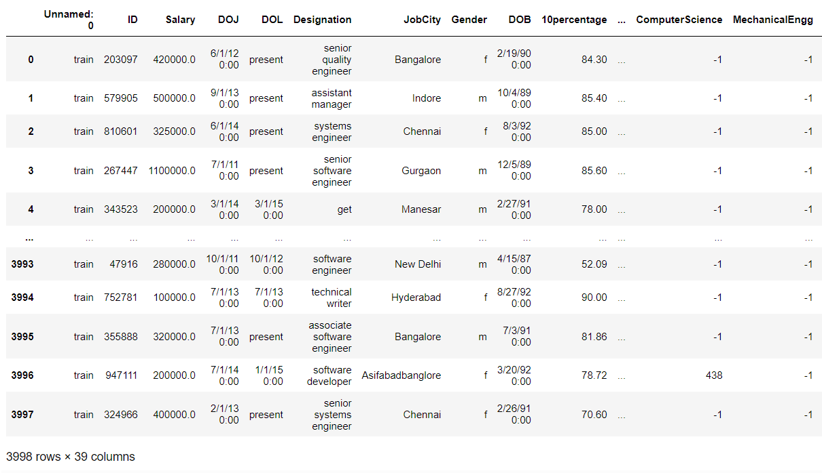
Given Data:

Slide 7
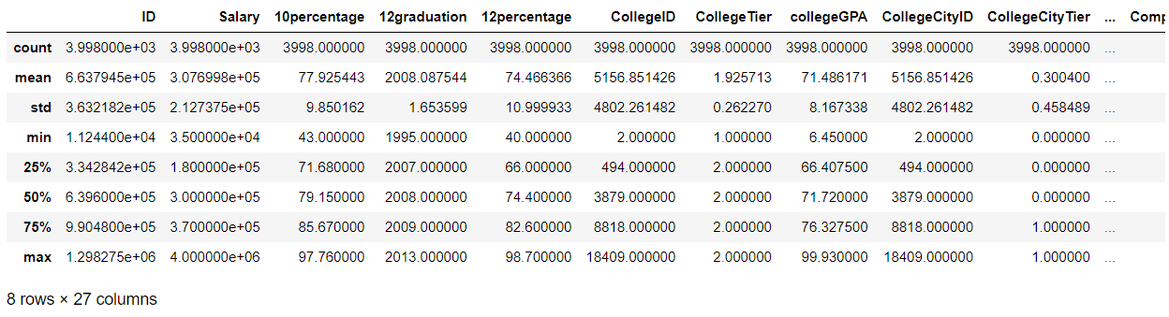

Slide 8
Data Visualisation:
Univariate Analysis Steps
Bivariate Analysis Steps and
Multivariate Analysis Steps

Slide 9
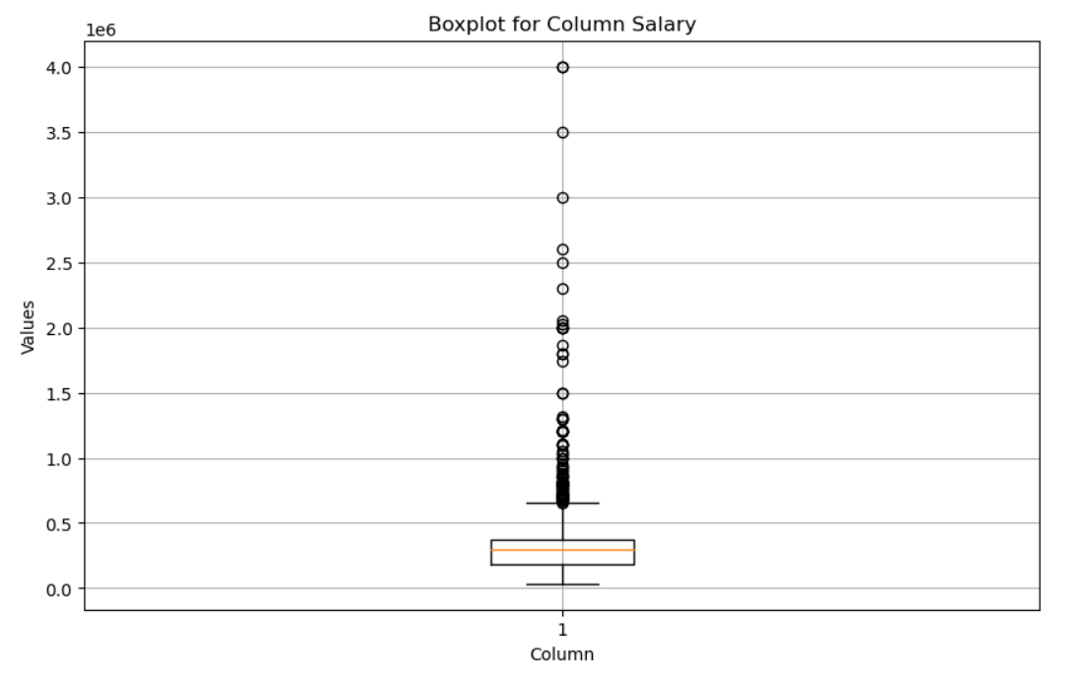
Observation : The boxplot visualizes the distribution of salary values, indicating a wide range of salaries with several outliers towards the higher end. The median salary lies within the lower quartile, suggesting a potential skewness towards lower incomes, while the upper whisker denotes considerable variability in higher salary ranges.

Slide 10
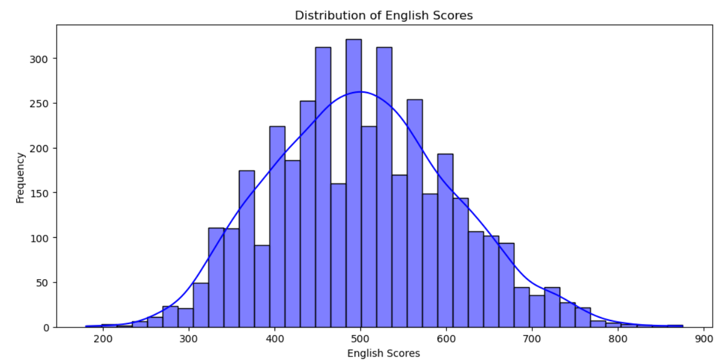
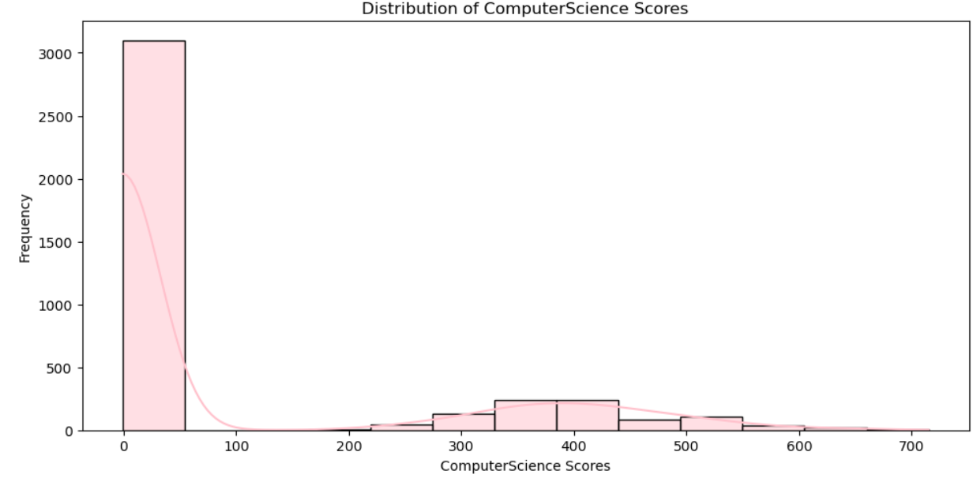
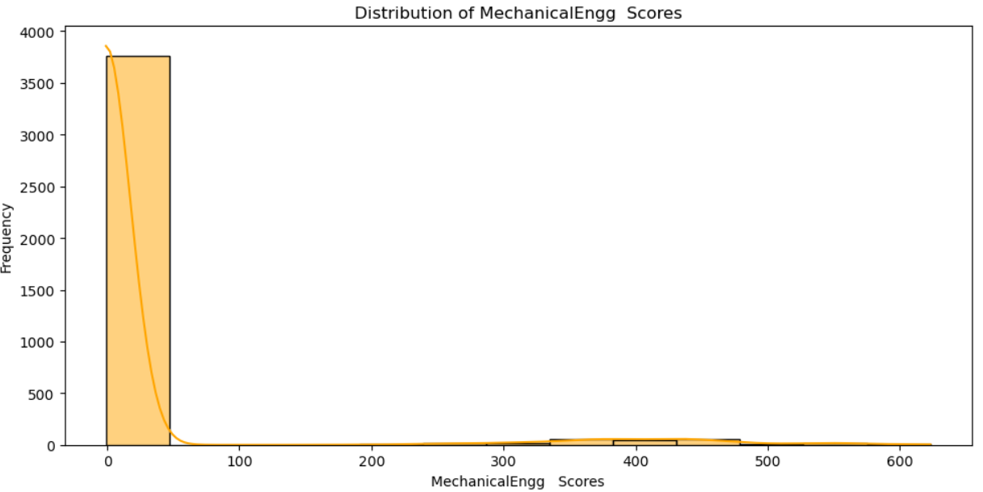
Observation : The histograms represents the 'English','ComputerScience', and 'MechanicalEngg' columns, showcasing the distribution of scores for each subject. Kernel density estimates (KDE) are included to provide smoother representations of the distributions. These visualizations offer insights into the spread and central tendencies of scores in each subject.

Slide 11
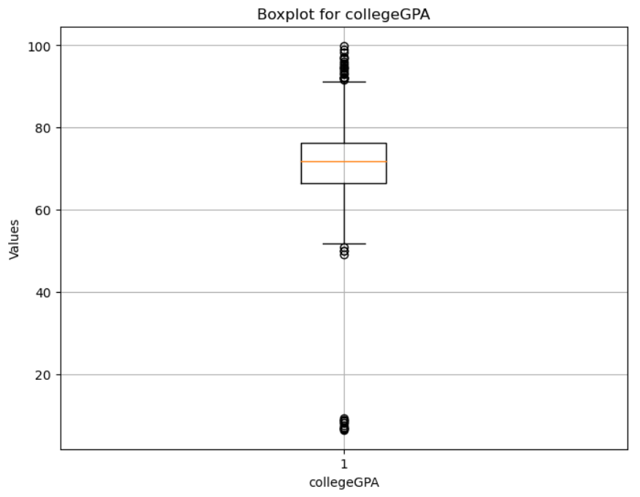
Observation: The boxplot illustrates the distribution of college GPAs, with a median value close to the center of the interquartile range. There are a few outliers on the lower end and some are in upper range, suggesting a relatively normal distribution with some students performing below the median GPA.

Slide 12
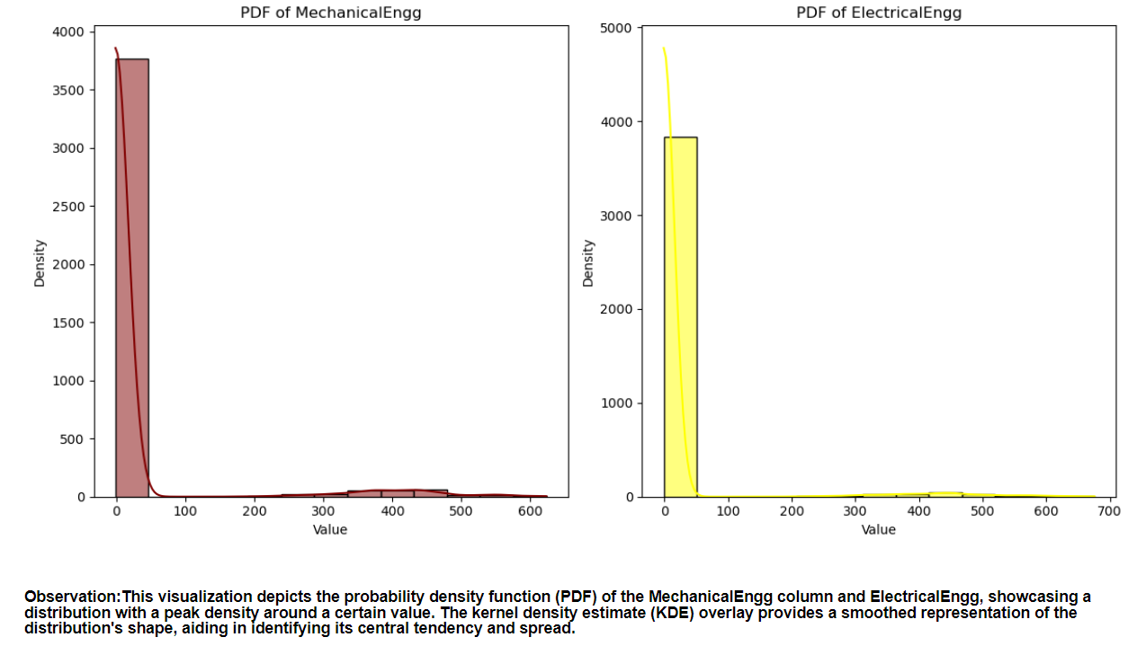

Slide 13
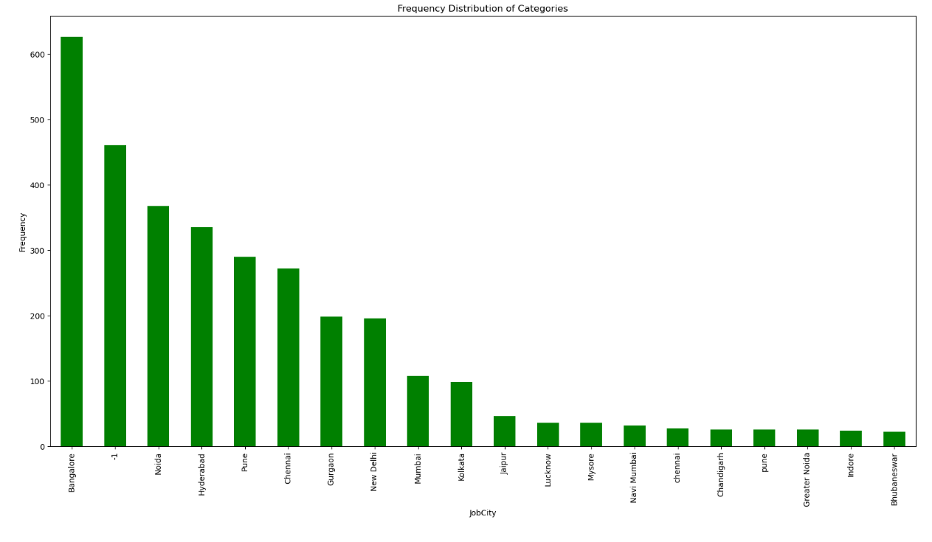
Observation : This bar plot illustrates the frequency distribution of the top 20 designations present in the dataset, showcasing the most common job titles. The ‘ JobCity' category 'Frequency' demonstrates a varied distribution, with certain designations appearing more frequently than others, while the horizontal orientation of the x-axis labels aids readability for a larger number of categories. from above bar we can say that the software engineer has the highest frequency followed by software developer.

Slide 14
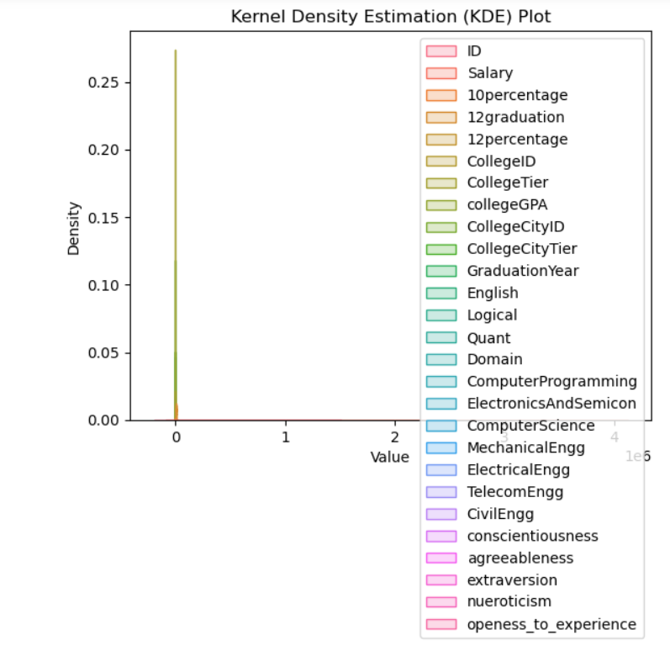
Observation : The Kernel Density Estimation (KDE) plot visually represents the distribution of multiple variables in the DataFrame df, highlighting the density of data points across their respective ranges. The shaded areas emphasize regions with higher data density, providing insights into the overall distribution pattern and concentration of values within the dataset.

Slide 15
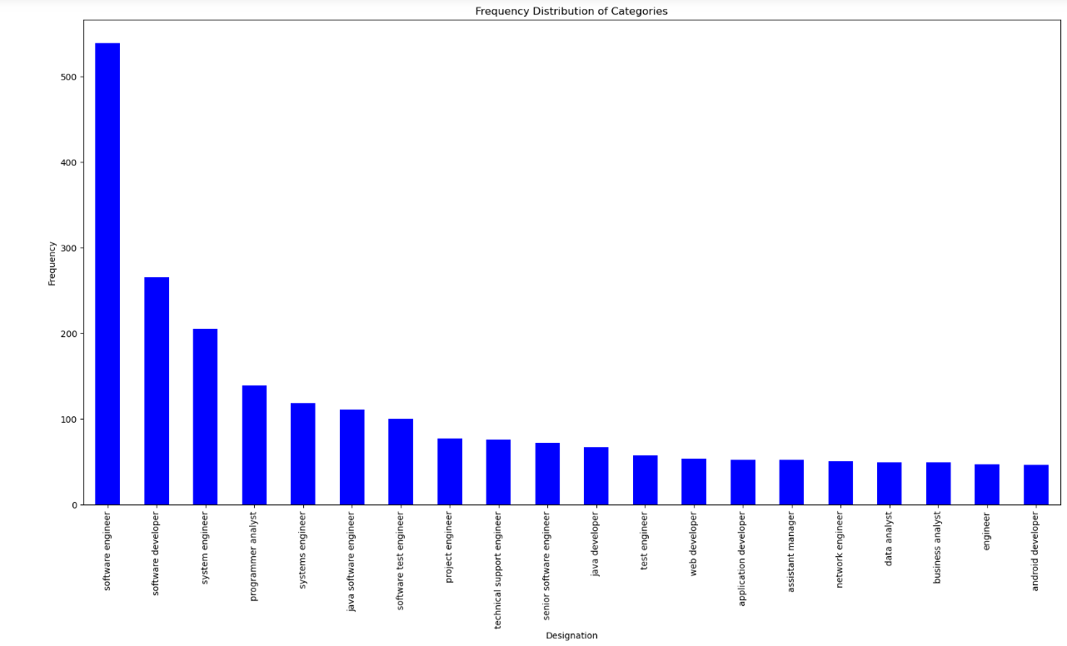
Observation:This bar plot displays the frequency distribution of the top 20 job cities recorded in the dataset, with 'Designation' on the x-axis and the frequency of occurrences on the y-axis. it represents the city Bangalore has the highest frequency

Slide 16
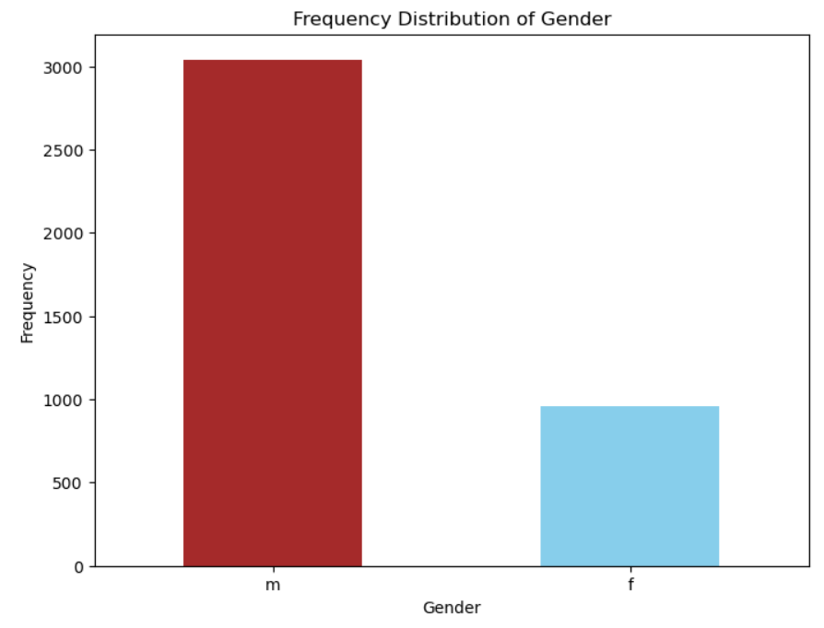
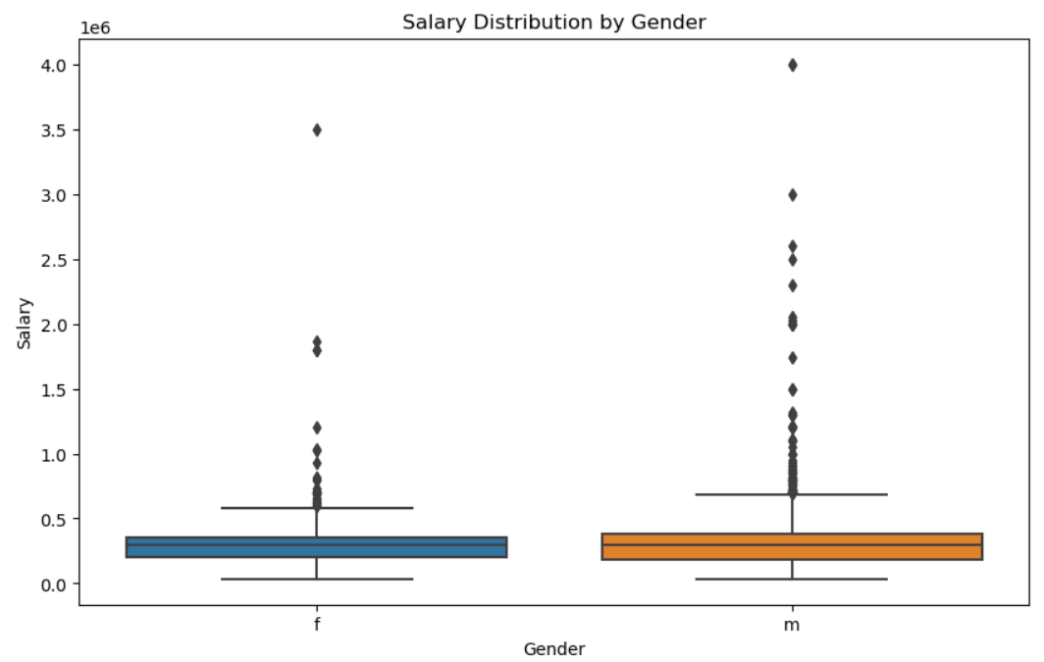
Observation:Look for significant differences in the median salary between genders. A higher or lower median might indicate gender disparities. as we can observes that the gender male as the highest salary outliers as compare to the female

Slide 17
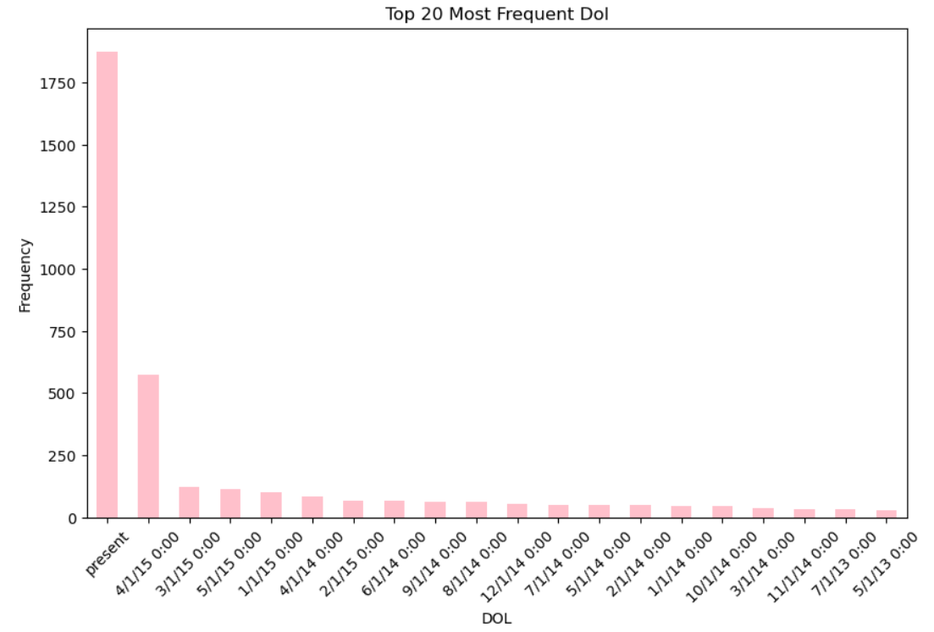
Observation:the above bar plot represents the the top 20 Dates of lossing. as we can see on present on this date has the highest number of lossing similarly 4/1/15 is the second highest date of lossing

Slide 18
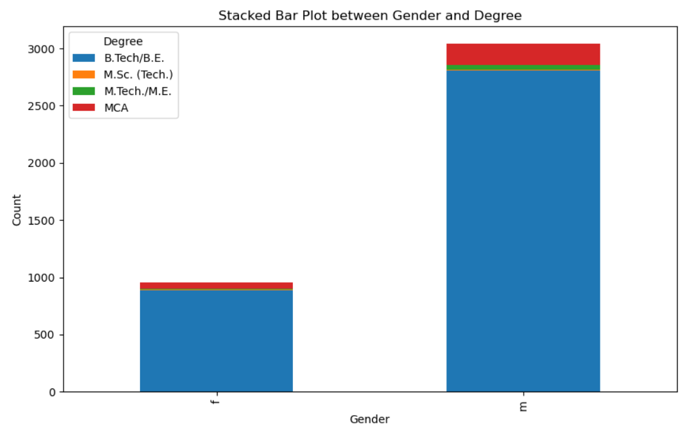
Observation: The stacked bar plot illustrates the distribution of degree types across genders. It highlights the gender-wise breakdown of degree categories, showcasing the relative frequencies of each degree type among males and females. The plot reveals the gender disparities in educational backgrounds, with certain degrees being more prevalent among one gender compared to the other. here we can observe that number of males has the has degree in B.Tech/BE and the male who are completed MCA has second highest number, in female also most of the female completed degree in B.Tech/B.E and few has done MCA andd very few has completed M.SC.(Tech.)

Slide 19
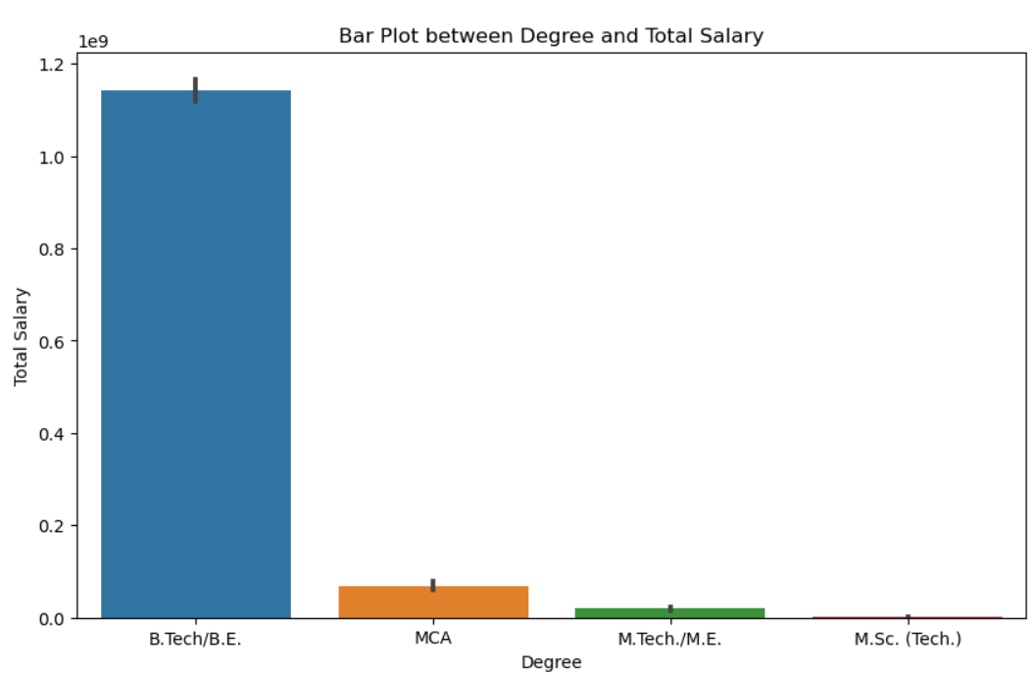
Observation: The strip plot between gender and specialization displays the distribution of different specializations across genders. It reveals the clustering of various specializations based on gender, highlighting potential gender-based preferences or trends in educational pursuits.
The bar plot illustrates the total salary aggregated by degree types, providing insights into the overall earning potential associated with different degrees. It enables comparison of the total salary earned across various degree categories, aiding in identifying degrees that contribute more significantly to overall earnings.

Slide 20
Conclusion:
In conclusion, the extensive data analysis yields several notable discoveries about the factors impacting pay levels in dataset. While certain criteria such as tenure and college level, have a strong link with compensation, others such as gender and academic performance have no relationship. After removing outliers. Age does not appear to be a determining factor in compensation.

Slide 21

THANK YOU

